Slide 1
Coffee Shop Sales Analysis
Priyadharshini V – DA Batch

Slide 2
Title & Objective
TITLE
Coffee Shop Sales Analysis
OBJECTIVE:
Analyze sales data to uncover trends, evaluate product performance, and support data-driven business decisions by creating dashboard.

Slide 3

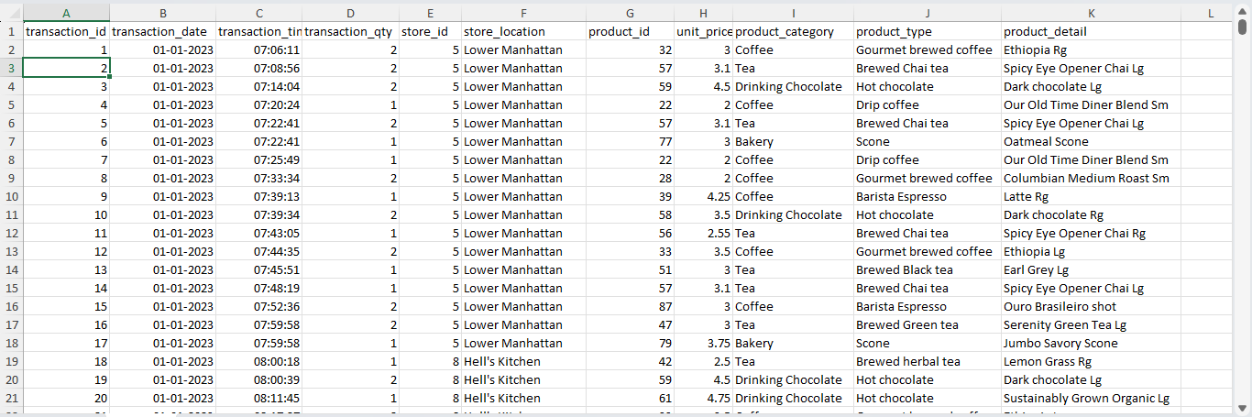
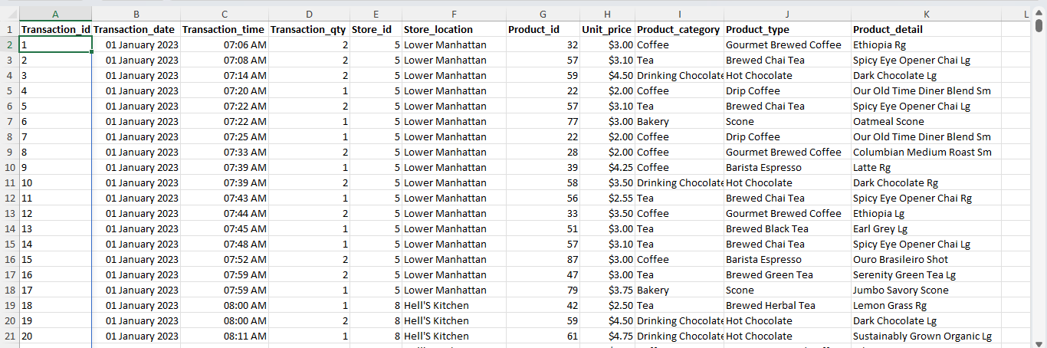
Dataset Description
Dataset :
It’s from Kaggle Platform
This is a Transactional sales data from a coffee shop Maven Roasters
Has more than 1L rows and 11 Columns
Data Cleaning:
Removed Blank values (no cells found)
Formatted dates, text , currency

Slide 4

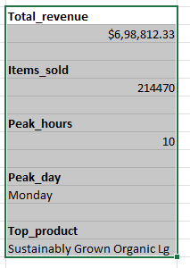
Calculations
Done by using Aggregate , Text , Date and Time Functions
Total sales , Revenue , Peak hour and Day

Slide 5
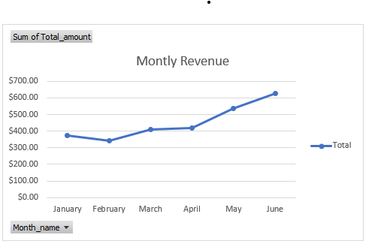
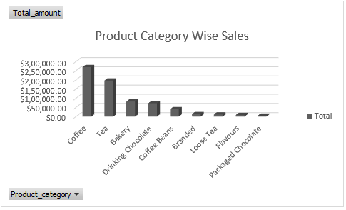
Pivot tables & Charts
Product Performance
Store Sales Analysis
Monthly Revenue

Slide 6
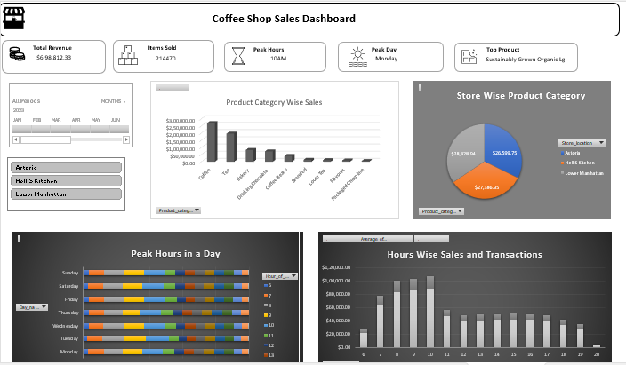
Dashboard
Content:
An interactive Excel dashboard was created to visualize key sales metrics.
Main dashboard features:
Total Sales overview
Slicers and Timeline and KPI
Visualizations using the created pivot charts

Slide 7
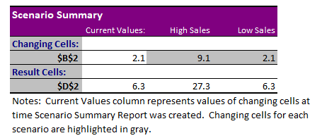
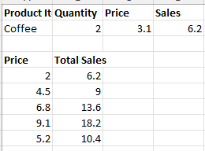
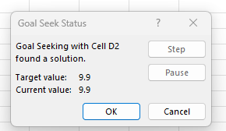
Key Analysis
What-If Analysis (impact of price changes)
Scenario Manager (compare pricing strategies)
Goal Seek (find price for target sales)

Slide 8
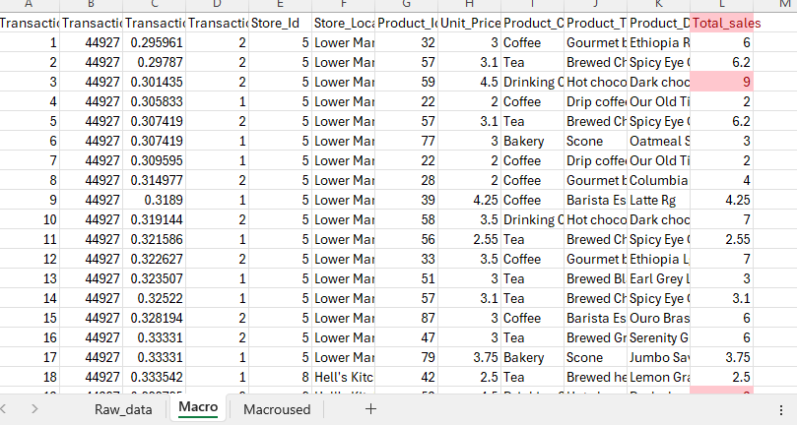
Macros:
Applied formatting for the header and added conditional formatting by highlighting the cell which has sales >7

Slide 9
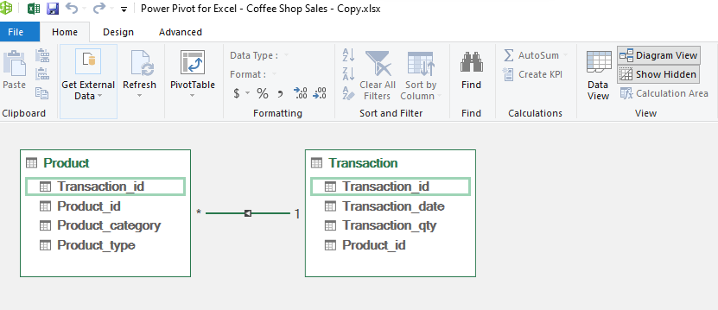
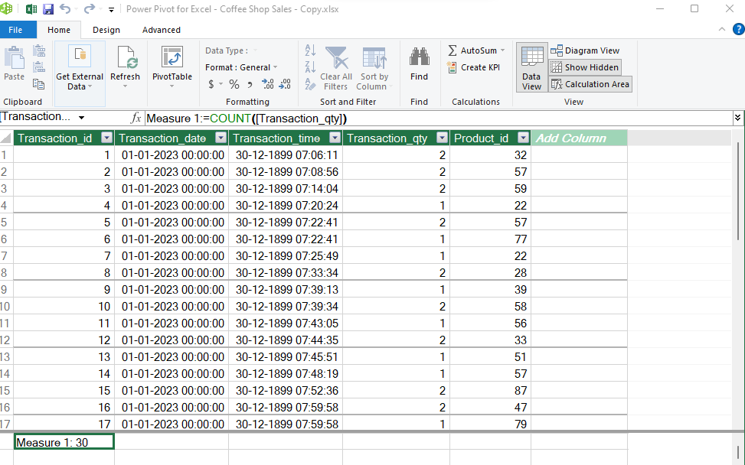
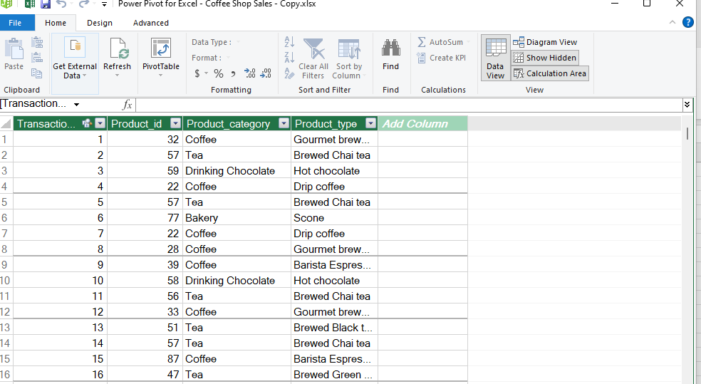
Power Pivot & Data Modeling
Two tables Transaction and Product are created
Generated Relationship between these two tables using diagram view
Used some DAX measure
Created a Pivot table from the power pivot

Slide 10
Insights & Recommendations
Insights:
Peak Sales Periods: Sales are highest during the morning hours and on weekends, indicating strong demand during breakfast and leisure times.
Top-Selling Products: Espresso/Coffee-based drinks consistently generate the most revenue, while specialty drinks have lower but steady sales.
Recommendations:
Promote Best Sellers: Highlight top-selling products with in-store promotions and loyalty rewards to maximize revenue.
Bundle Offers: Create more combo deals to encourage higher average transaction values.

Slide 11




Thankyou!

